Slide 1
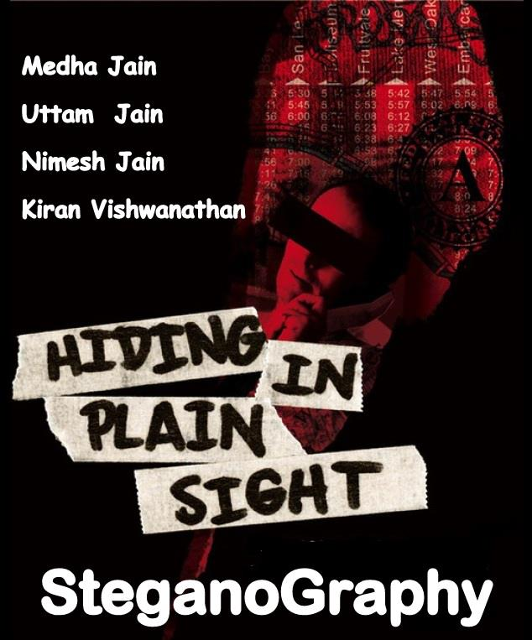

Slide 2
OverView
What is Steganography?
History Of Steganography
Physical And Digital techniques
Comparison Of Secret Communication Techniques
Steganography v/s Cryptography
Evolution
Basic Steganography Model
Steganography Terms
Types of StegoSystems

Slide 3
OverView
Types Of Steganography
Text Steganography
Image Steganography
Audio Steganography
Applications
Advantages v/s Disadvantages
Future Scope
Conclusion
References

Slide 4
What is Steganography?
Steganography is the art and science of writing hidden messages in such a way that no one, apart from the sender and intended recipient, suspects the existence of the message, a form of security through obscurity.
The word steganography is of Greek origin and means "concealed writing" from the Greek words steganos meaning "covered or protected", and graphein meaning "writing".
“Steganography means hiding one piece of data within another”.

Slide 5
Example
Since everyone can read, encoding text
in neutral sentences is doubtfully effective
Since Everyone Can Read, Encoding Text
In Neutral Sentences Is Doubtfully Effective
‘Secret inside’

Slide 6
History Of Steganography
The first recorded uses of steganography can be traced back to 440 BC when Herodotus mentions two examples of steganography in his Histories.
Demaratus sent a warning about a forthcoming attack to Greece by writing it directly on the wooden backing of a wax tablet before applying its beeswax surface.
Wax tablets were in common use then as reusable writing surfaces, sometimes used for shorthand.
Ancient Chinese wrote messages on fine silk, which was then crunched into a tiny ball and covered in wax. The messenger then swallowed the ball of wax.
Special “inks” were important steganographic tools even during Second World War.
During Second World War a technique was developed to shrink photographically a page of text into a dot less than one millimeter in diameter, and then hide this microdot in an apparently innocuous letter. (The first microdot has been spotted by FBI in 1941.)

Slide 7
Physical Techniques
Physical Techniques
Hidden messages within wax tablets
Hidden messages on messenger's body
Hidden messages on paper written in secret inks
Messages written in Morse code on knitting yarn and then knitted into a piece of clothing worn by a courier
Messages written on envelopes in the area covered by postage stamps.

Slide 8
Digital Techniques
Digital Techniques
Concealing messages within the lowest bits of noisy images or sound files.
Chaffing and winnowing.
Modifying the echo of a sound file (Echo Steganography)
Including data in ignored sections of a file, such as after the logical end of the carrier file.

Slide 9
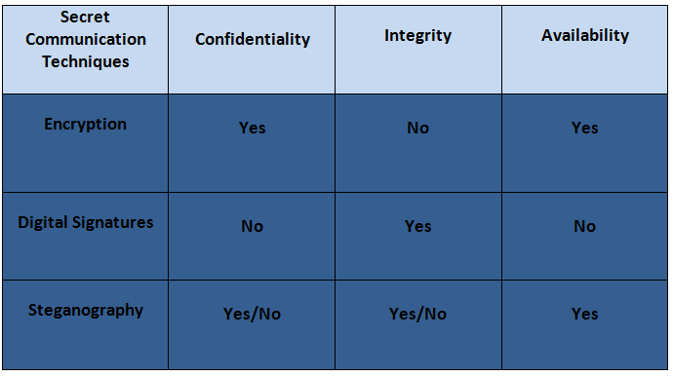
Comparison Of Secret Communication Techniques

Slide 10
Steganography V/s Cryptography
Steganography | Cryptography
Unknown message passing | Known message passing
Steganography prevents discovery of the very existence of communication | Encryption prevents an unauthorized party from discovering the contents of a communication
Little known technology | Common technology
Technology still being develop for certain formats | Most of algorithm known by all
Once detected message is known | Strong current algorithm are resistant to attacks ,larger expensive computing power is required for cracking
Steganography does not alter the structure of the secret message | Cryptography alter the structure of the secret message

Slide 11
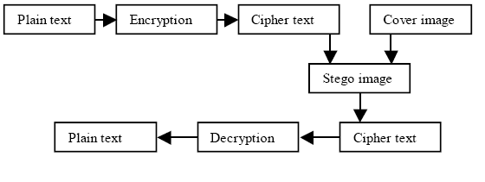
Combined Crypto- Steganography
Invisible
Merge
Steganography
Encryption

Slide 12

Evolution
Cryptography
Steganography
Watermarking

Slide 13
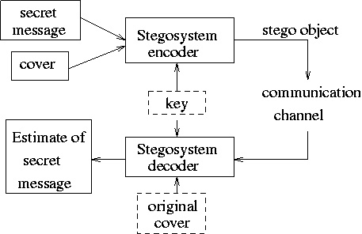
Basic Steganography Model

Slide 14
Steganography Terms
Carrier or Cover File - A Original message or a file in which hidden information will be stored inside of it .
Stego-Medium - The medium in which the information is hidden.
Embedded or Payload - The information which is to be hidden or concealed.
Steganalysis - The process of detecting hidden information inside a file.

Slide 15
Types Of Stegosystems
There are three basic types of stegosystems
Pure stegosystems - no key is used.
Secret-key stegosystems - secret key is used.
Public-key stegosystems - public key is used

Slide 16
Text Steganography
Text steganography can be applied in the digital makeup format such as PDF, digital watermark or information hiding
It is more difficult to realize the information hiding based on text. The simplest method of information hiding is to select the cover first, adopt given rules to add the phraseological or spelling mistakes, or replace with synonymy words.
E.g 1] Textto setups some sentence structure in advance, fills in the empty location by arranged words,
and then the text doesn’t have phraseological mistakes, but have some word changes or morphology mistakes.
2] TextHide hides the information in the manner of text overwriting and words’ selection.

Slide 17
Text Steganography Methods
Text Steganography in Markup Languages[HTML]
Text Steganography in Specific characters in words
Line shifting Method
Word shifting
Open spaces
Semantic methods
Character Encoding

Slide 18
Examples of Text Steganography
An example of a message containing cipher text by German Spy in World War II:
“Apparently neutral's protest is thoroughly discounted And ignored. Isman hard hit. Blockade issue affects Pretext for embargo on by products, ejecting suets and Vegetable oils. ”
Taking the second letter in each word the following message emerges:
Pershing sails from NY June 1.

Slide 19


Examples of Text Steganography
Minor changes to shapes of characters

Slide 20
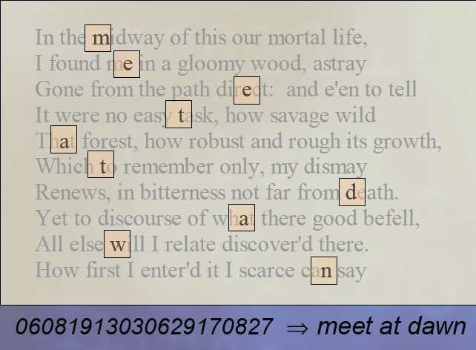
Examples of Text Steganography

Slide 21
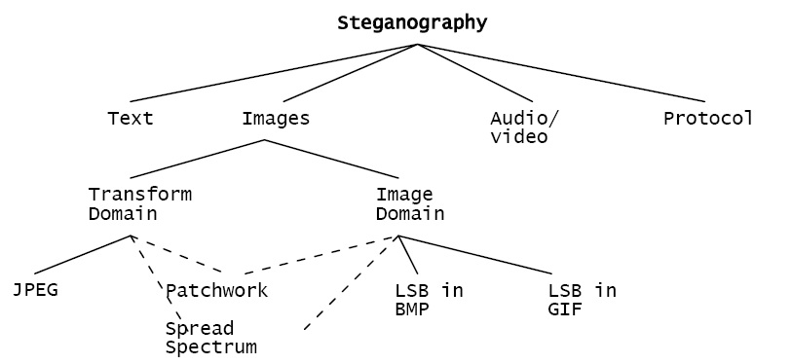
Image Steganography
Using image files as hosts for steganographic messages takes advantage of the limited capabilities of the human visual system
Some of the more common method for embedding messages in image files can be categorized into two main groups, image domain methods and transform domain methods

Slide 22
Image And Transform Domain
Image – also known as spatial – domain techniques embed messages in the intensity of the pixels directly, while for transform – also known as frequency – domain, images are first transformed and then the message is embedded in the image
Image domain techniques encompass bit-wise methods that apply bit insertion and noise manipulation and are sometimes characterised as “simple systems”
Steganography in the transform domain involves the manipulation of algorithms and image transforms

Slide 23
LSB [Least Significant bit] Method
Least significant bit (LSB) insertion is a common, simple approach to embedding information in a cover image
The least significant bit (in other words, the 8th bit) of some or all of the bytes inside an image is changed to a bit of the secret message
When using a 24-bit image, a bit of each of the red, green and blue colour components can be used, since they are each represented by a byte. In other words, one can store 3 bits in each pixel. An 800 × 600 pixel image, can thus store a total amount of 1,440,000 bits or 180,000 bytes of embedded data
In its simplest form, LSB makes use of BMP images, since they use lossless compression

Slide 24
Example Of LSB Method
A grid for 3 pixels of a 24-bit image can be as follows:
(00101101 00011100 11011100)
(10100110 11000100 00001100)
(11010010 10101101 01100011)
When the number 200, which binary representation is 11001000, is embedded into the least significant bits of this part of the image, the resulting grid is as follows:
(00101101 00011101 11011100)
(10100110 11000101 00001100)
(11010010 10101100 01100011)

Slide 25

Example Of Image Steganography
Original Stego Original Stego
Image Image Image Image

Slide 26
Audio Steganography
Embedding secret messages into digital sound is known as
audio Steganography.
Audio Steganography methods can embed messages in WAV, AU, and even MP3 sound files.
The properties of the human auditory system (HAS) are exploited in the process of audio Steganography

Slide 27
Audio Steganography
To embed data secretly onto digital audio file there are few techniques introduced :
LSB Coding
Phase Coding
Parity Coding
Spread Spectrum

Slide 28
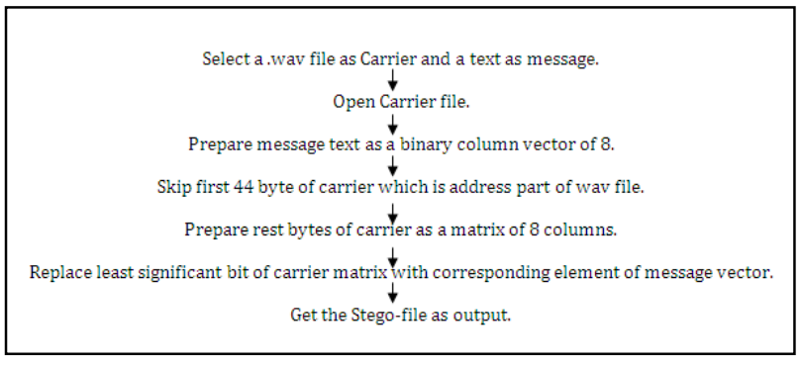
Flowchart Of Audio Steganography

Slide 29
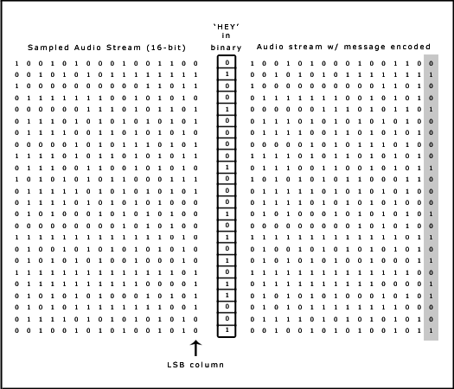
Example of LSB Method
The message 'HEY' is encoded in a 16-bit CD quality sample using the LSB method.
Here the secret information is ‘HEY’ and the cover file is audio file. HEY is to be embedded inside the audio file. First the secret information ‘HEY’ and the audio file are converted into bit stream.
The least significant column of the audio file is replaced by the bit stream of sectet information ‘HEY’. The resulting file after embedding secret information ‘HEY’ is called Stego-file.

Slide 30
Applications
Confidential communication and secret data storing
Steganography provides us with:
Potential capability to hide the existence of confidential data
Hardness of detecting the hidden (i.e., embedded) data
Strengthening of the secrecy of the encrypted data
Protection of data alteration
Access control system for digital content distribution
Media Database systems

Slide 31
Applications
Usage in modern printers
Alleged use by terrorists
Alleged use by intelligence services

Slide 32
Steganography Tools
Steganos
S-Tools (GIF, JPEG)
StegHide (WAV, BMP)
Invisible Secrets (JPEG)
JPHide
Camouflage
Hiderman

Slide 33
Future Scope
Steganography, though is still a fairly new idea. There are constant advancements in the computer field, suggesting advancements in the field of steganography as well. It is likely that there will soon be more efficient and more advanced techniques for Steganalysis. A hopeful advancement is the improved sensitivity to small messages. Knowing how difficult it is to detect the presence of a fairly large text file within an image, imagine how difficult it is to detect even one or two sentences embedded in an image! It is like finding a microscopic needle in the ultimate haystack.
What is scary is that such a small file of only one or two sentences may be all that is needed to commence a terrorist attack. In the future, it is hoped that the technique of Steganalysis will advance such that it will become much easier to detect even small messages within an image.

Slide 34
Conclusion
Interest in the use of steganography in our current digital age can be attributed to both the desire of individuals to hide communication through a medium rife with potential listeners, or in the case of digital watermarking, the absolute necessity of maintaining control over one’s ownership and the integrity of data as it passes through this medium. This increased interest is evidenced in the sheer number of available tools to provide easy steganographic techniques to the end user, as well as the proliferation of research and press on the topic.
The intent of this presentation was to cover some of the more common methods of data hiding using widespread file formats and easily available tools as an introduction ,to the primary concepts of steganography. These discussions should serve as a starting point to the exploration of more complex steganographic techniques involving, for example, the use of network packets and unused hard disk space as cover medium, or the more complex methodologies used on our standard image and audio files.

Slide 35
References
http://en.wikipedia.org/wiki/Steganography
S. William, Cryptography and Network Security: Principles and Practice, 2nd edition, Prentice-Hall, Inc., 1999 pp 23-50
Bandyopadhyay, S.K., 2010. An Alternative Approach of Steganography Using Reference Image.
Bloom,J. A. et al., 2008. Digital watermarking and Steganography. 2nd edition
A. Westfield. "F5 - A Steganographic Algorithm: High Capacity Despite Better Steganalysis", Lecture Notes in Computer Science, vol. 2137, pp. 289-302, 2001.
Hide & Seek: An Introduction to Steganography: Niles Provos and Peter Honey man
Artz, D., “Digital Steganography: Hiding Data within Data”, IEEE Internet Computing Journal, June 2001

Slide 36


